Slide 1
Local Government Development Project Automation
Bringing back the power to the people

Slide 2
Collaboration Diagrams

Slide 3
Table of contents
Introduction
Subsystems List
UseCase Diagram
Collaboration Diagram

Slide 4
Subsystems List
Voting Subsystem
Account Supervision
Project Box & Feedback
Distributed Content Generation
Big Data Analytics

Slide 5
Voting Subsystem

Slide 6
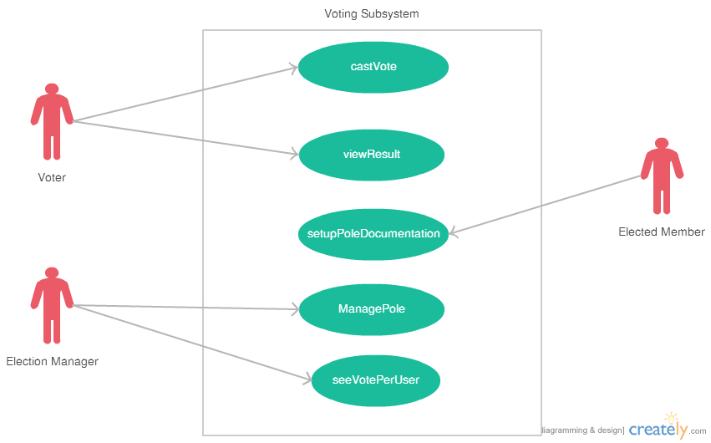
Use Case Diagram

Slide 7
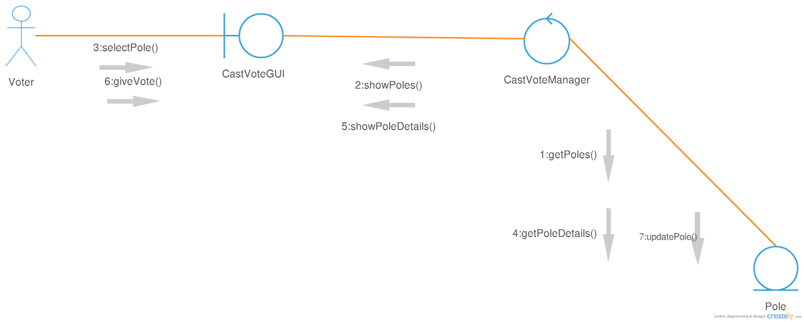
1.1 Class Diagram of CastVote

Slide 8
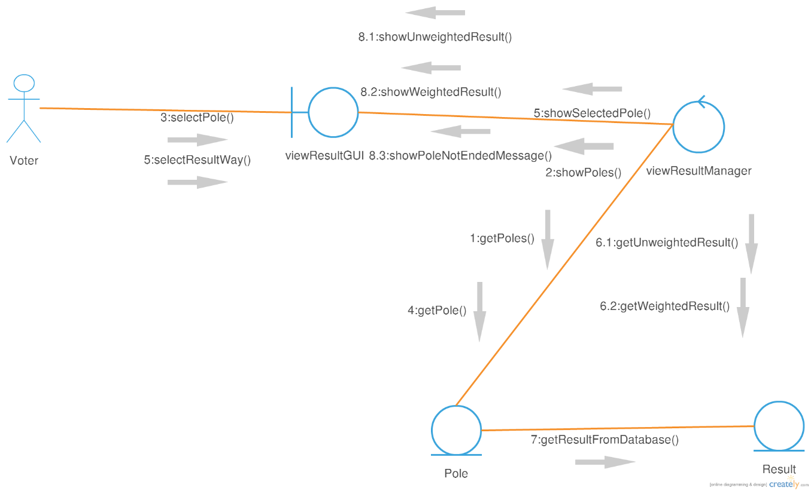
1.2 Class Diagram of ViewResult

Slide 9
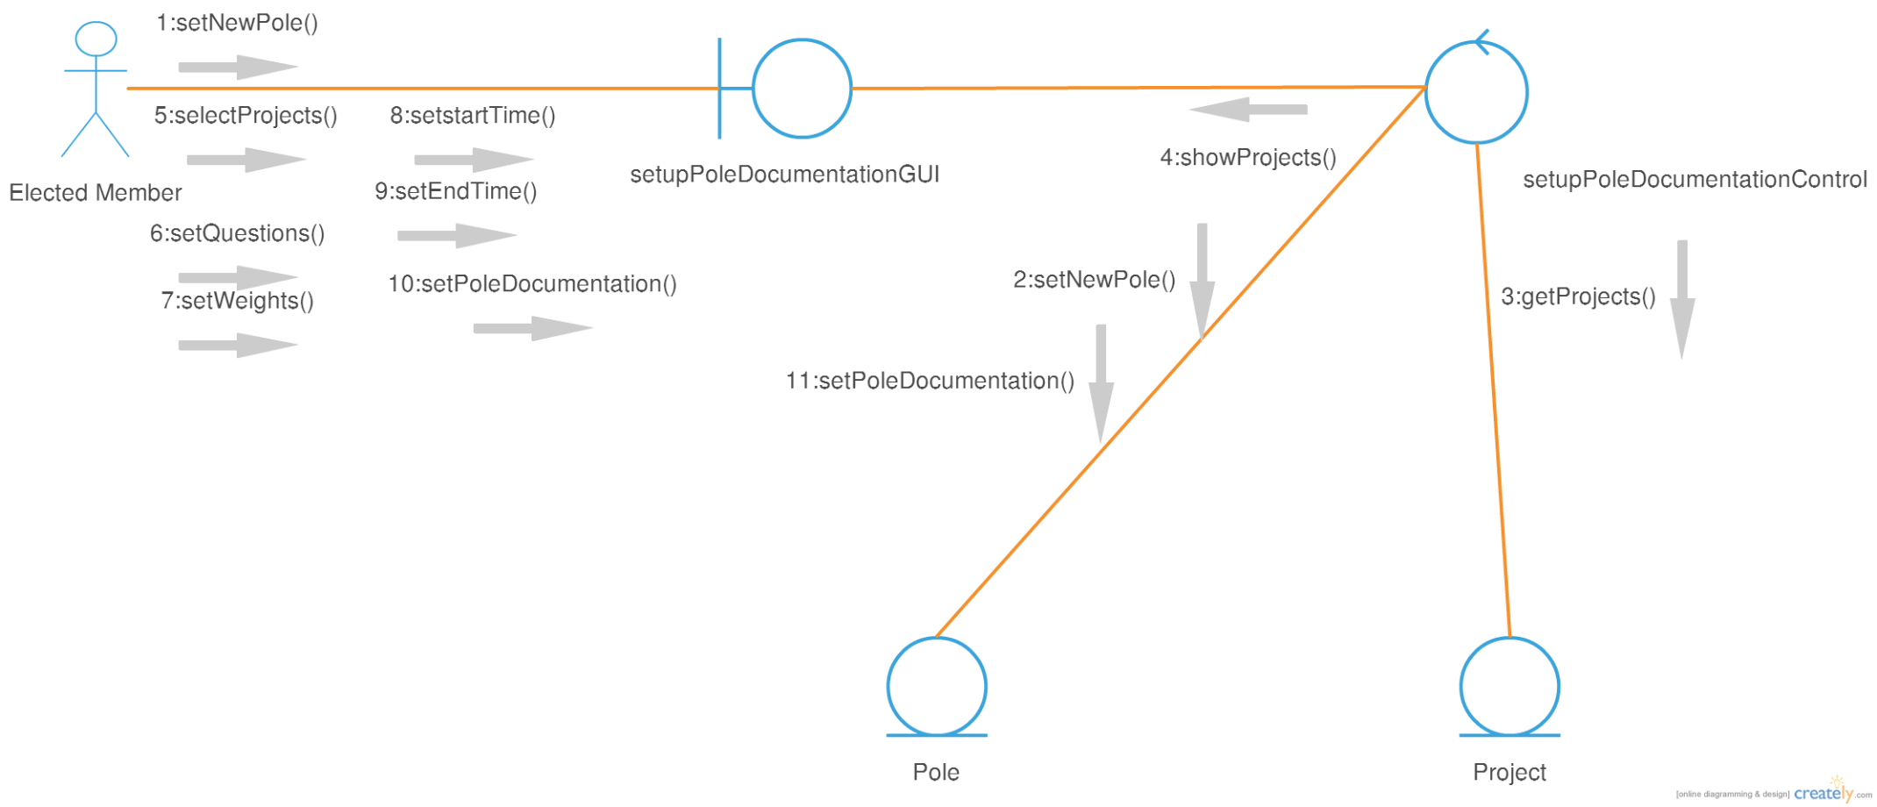
1.3 Class Diagram of SetPoleDocumentation

Slide 10
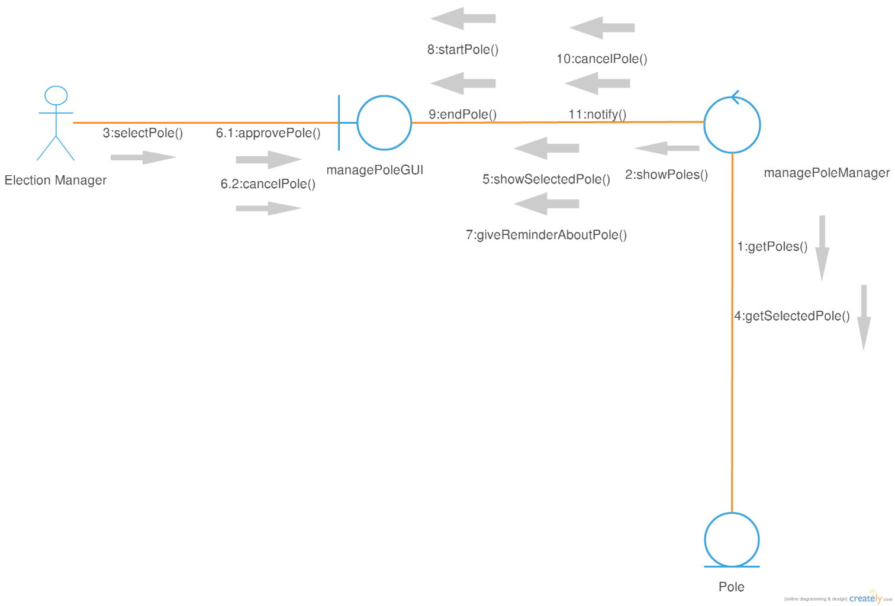
1.4 Class Diagram of ManagePole

Slide 11
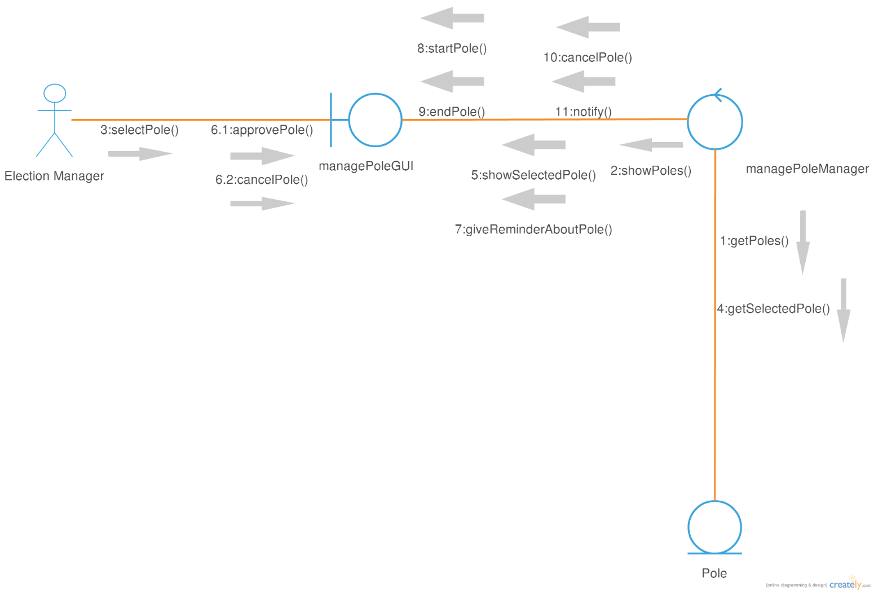
1.5 Class Diagram of SeeVotePerUser

Slide 12
Account Supervision Subsystem

Slide 13
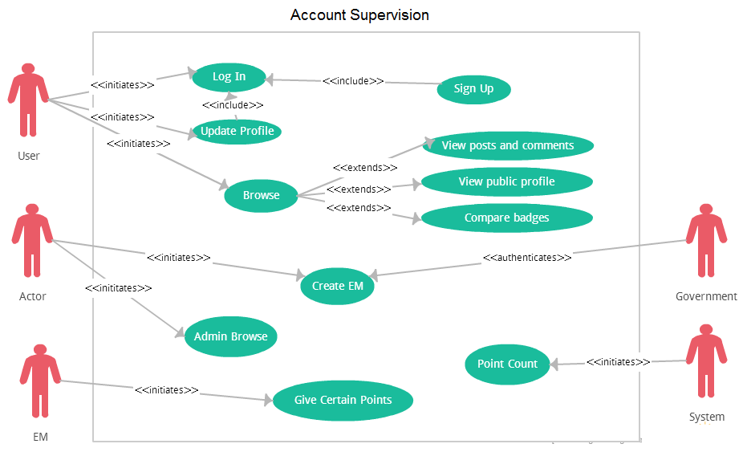
Use Case Diagram

Slide 14
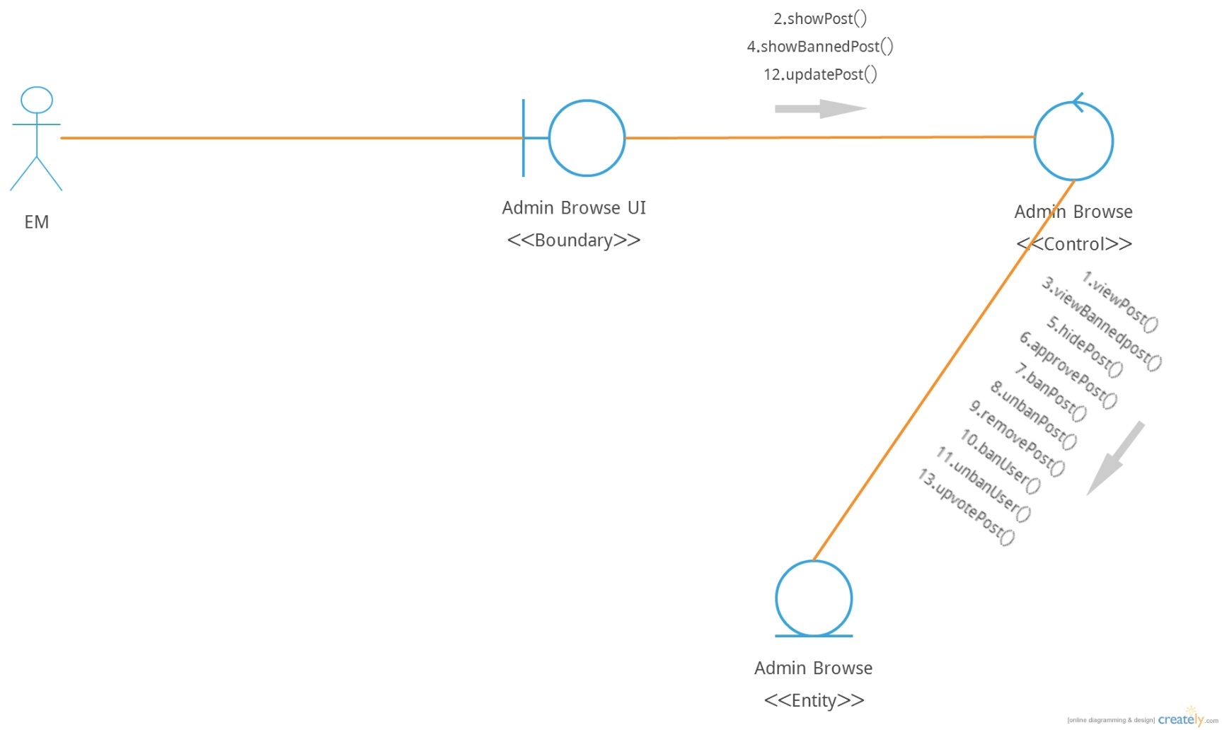
2.1 Class Diagram of AdminBrowse

Slide 15
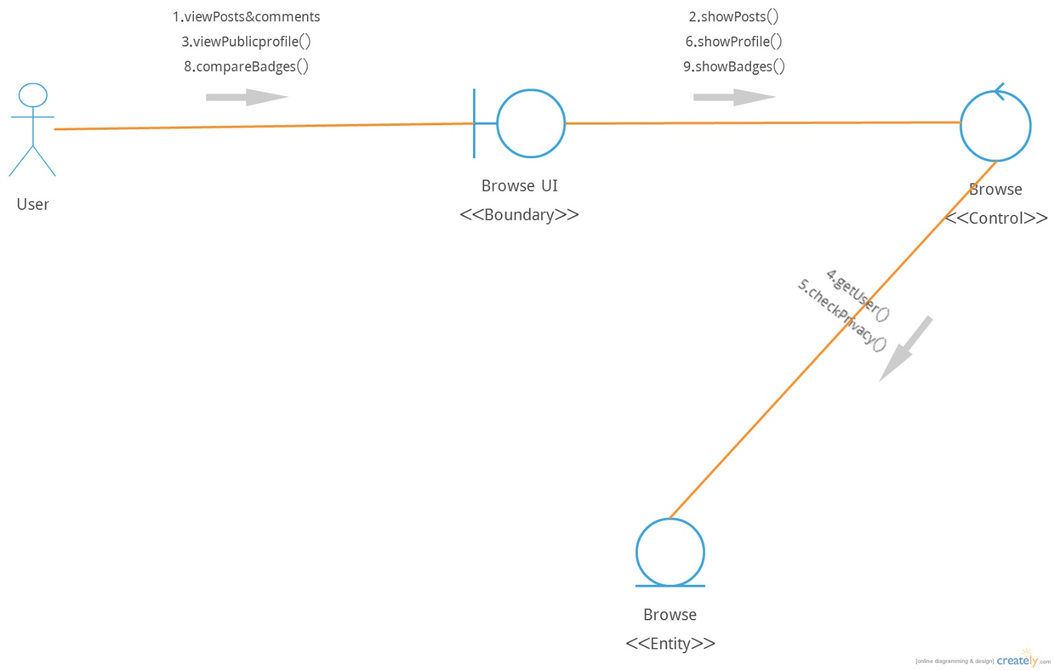
2.2 Class Diagram of Browse

Slide 16
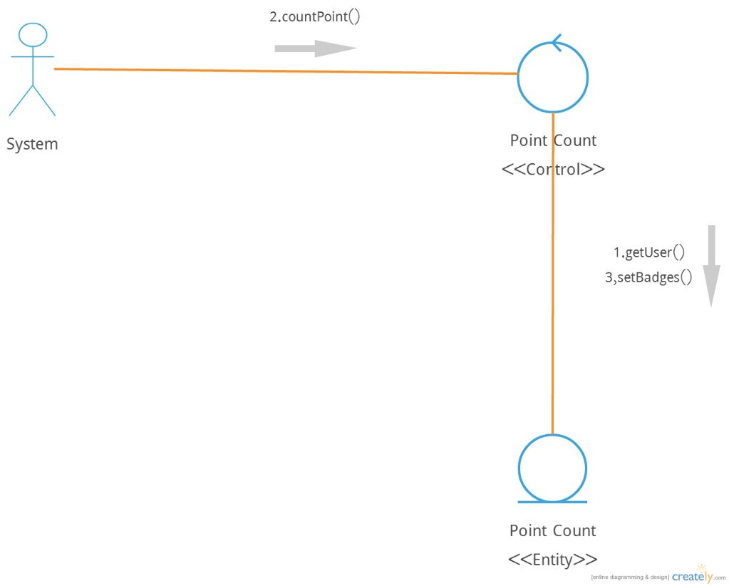
2.3 Class Diagram of CountPoint

Slide 17
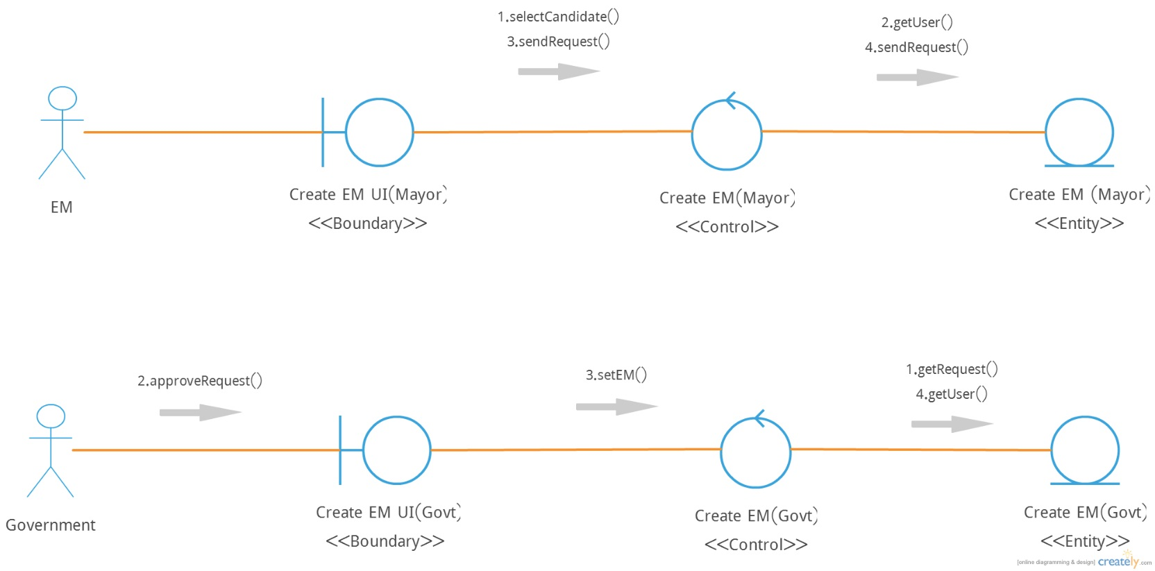
2.4 Class Diagram of CreateElectedMember

Slide 18
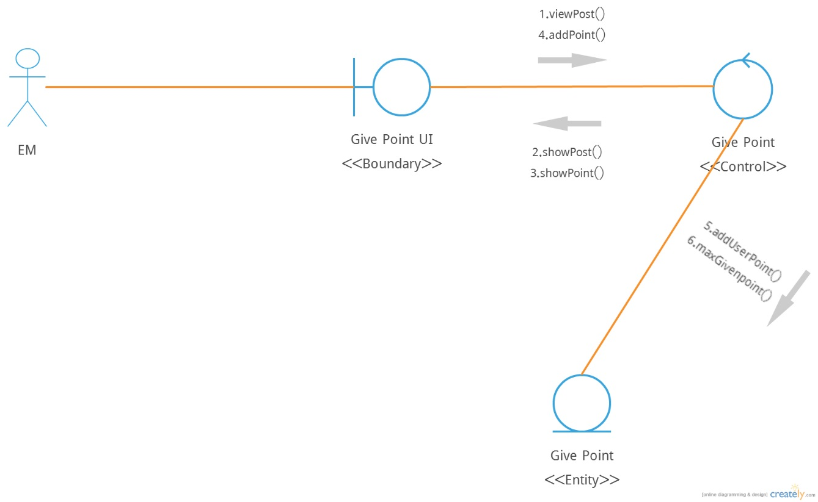
2.5 Class Diagram of GivePoint

Slide 19
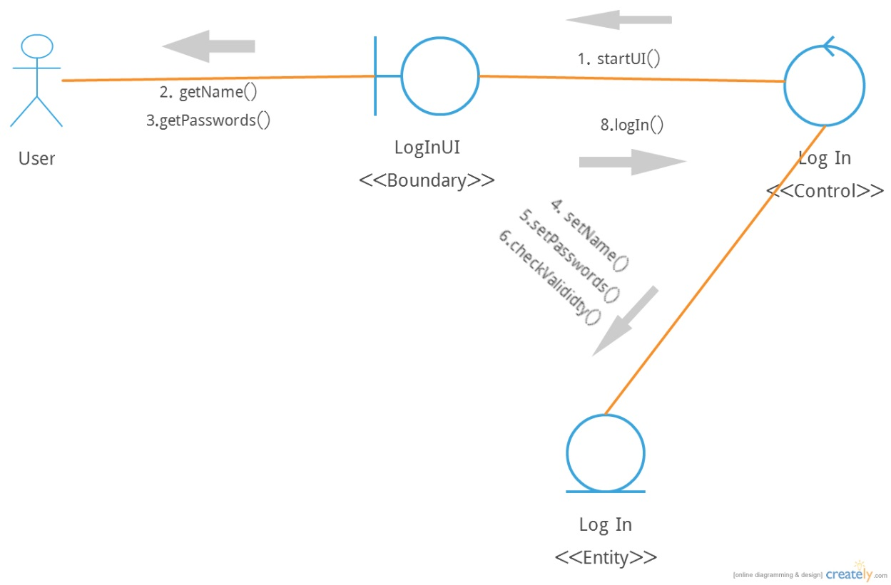
2.6 Class Diagram of Login

Slide 20
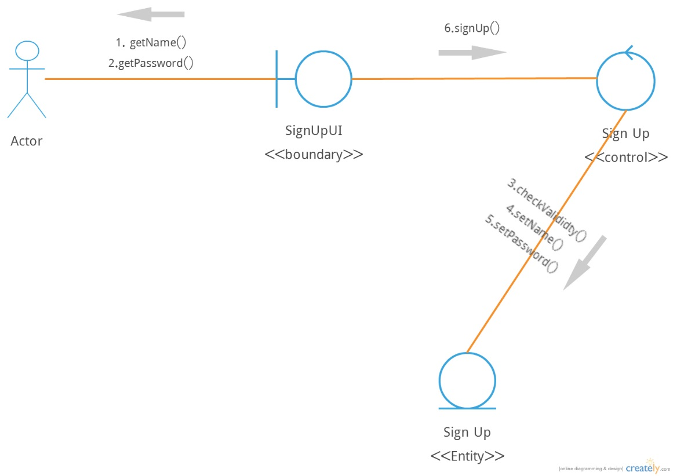
2.7 Class Diagram of Signup

Slide 21
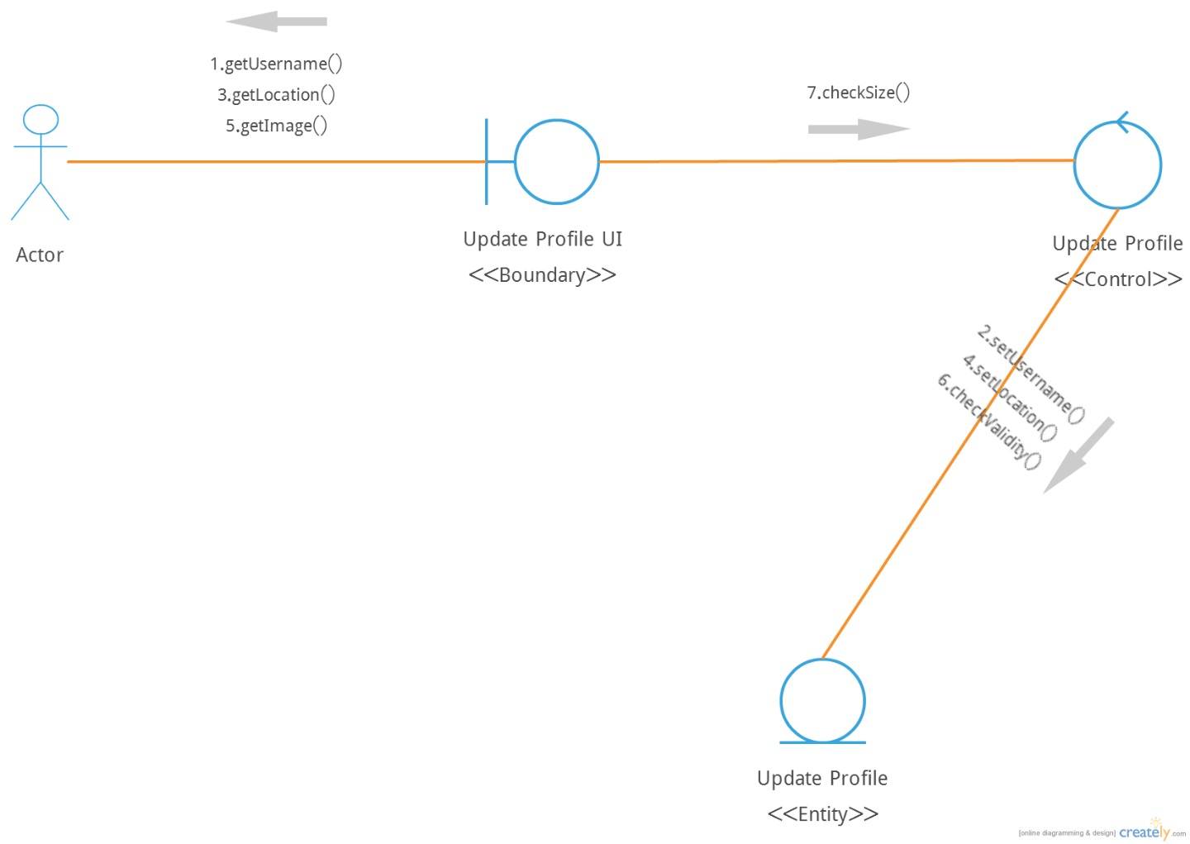
2.8 Class Diagram of UpdateProfile

Slide 22
Projectbox and Feedback Subsystem

Slide 23
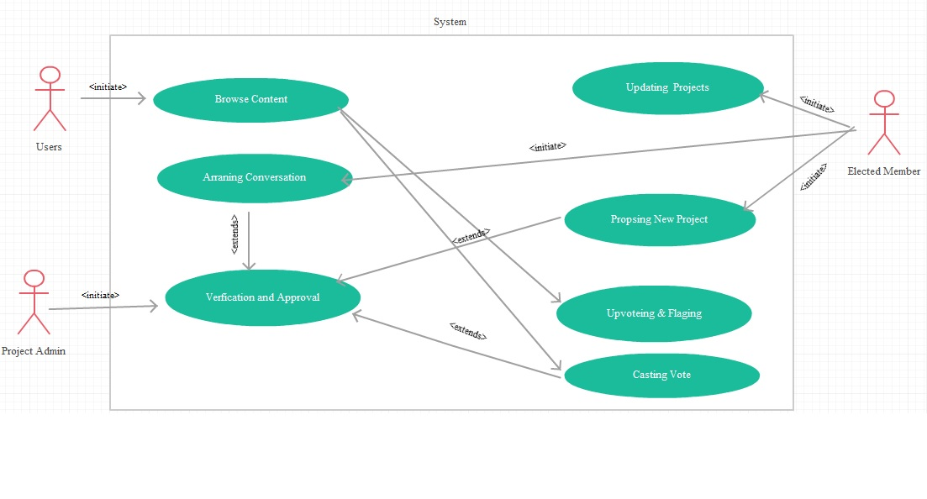
Use Case Diagram

Slide 24
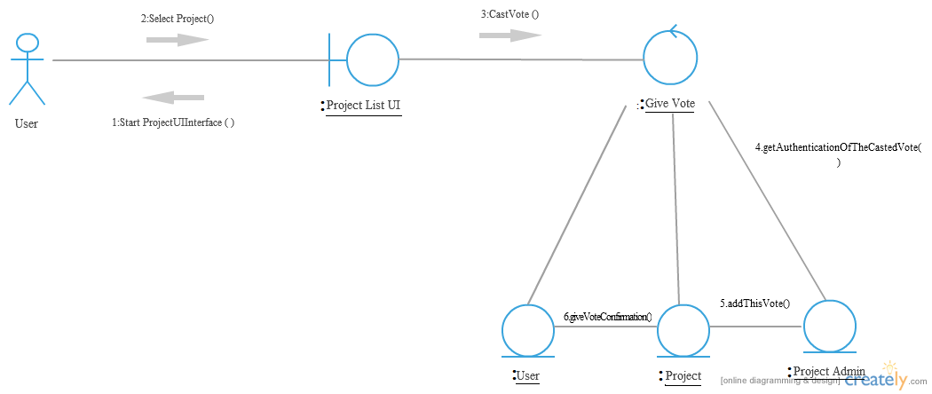
3.1 Class Diagram of CastVote

Slide 25
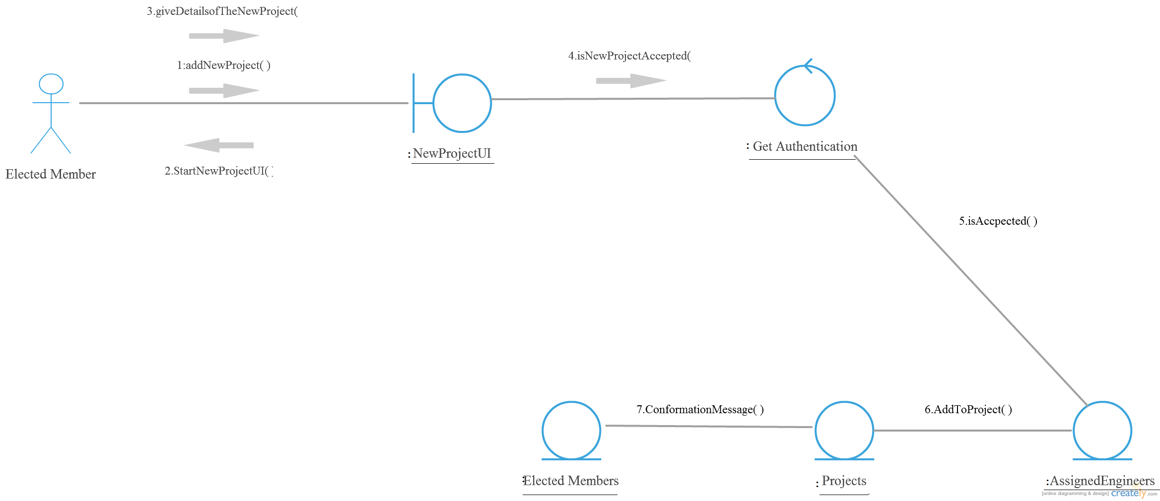
3.2 Class Diagram of ProposeNewProject

Slide 26
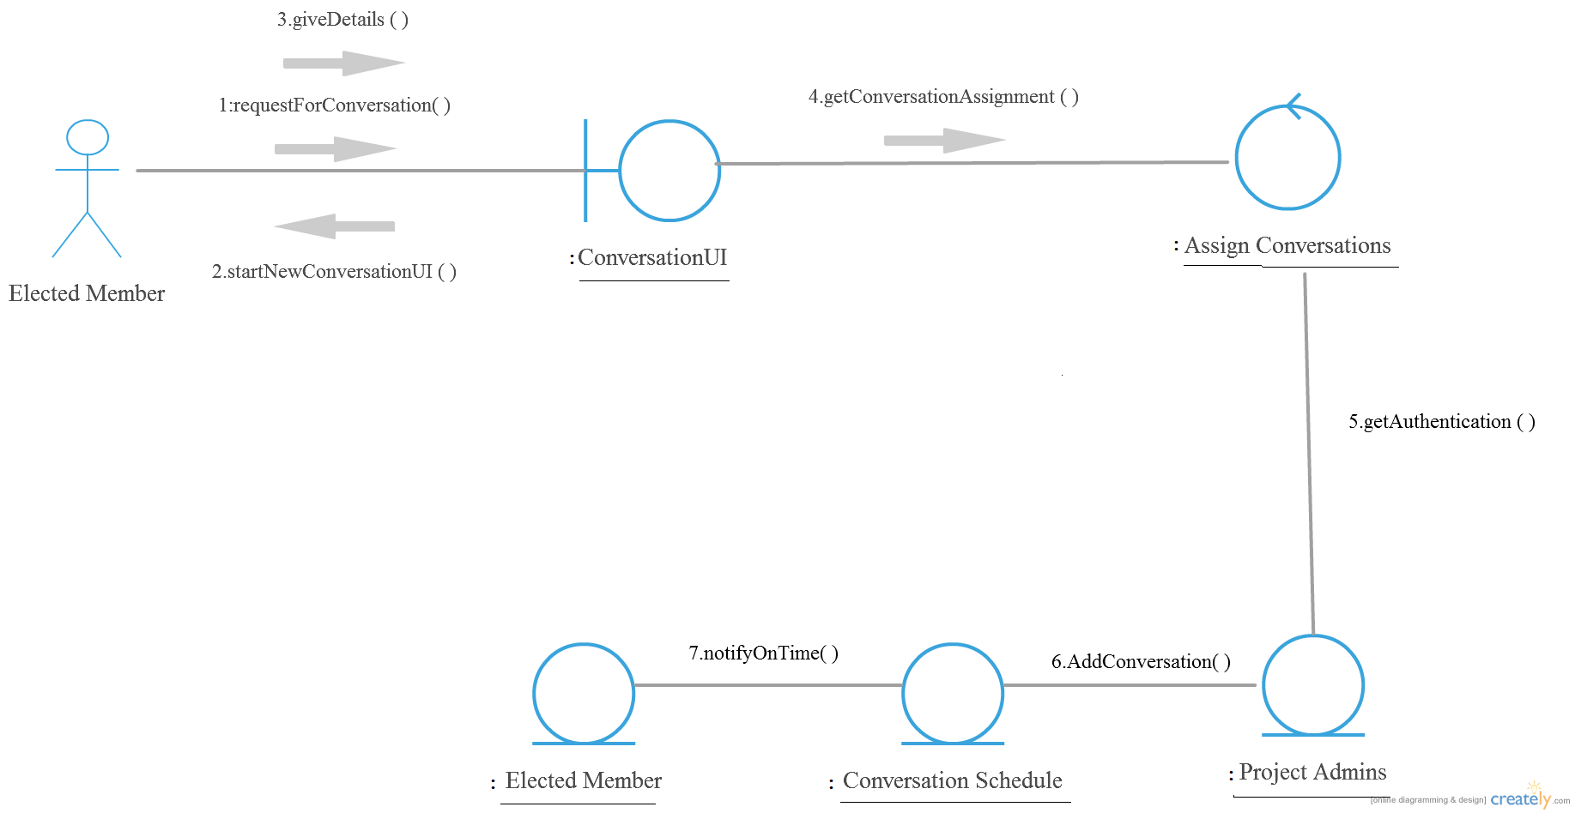
3.3 Class Diagram of ArrangeConversation

Slide 27
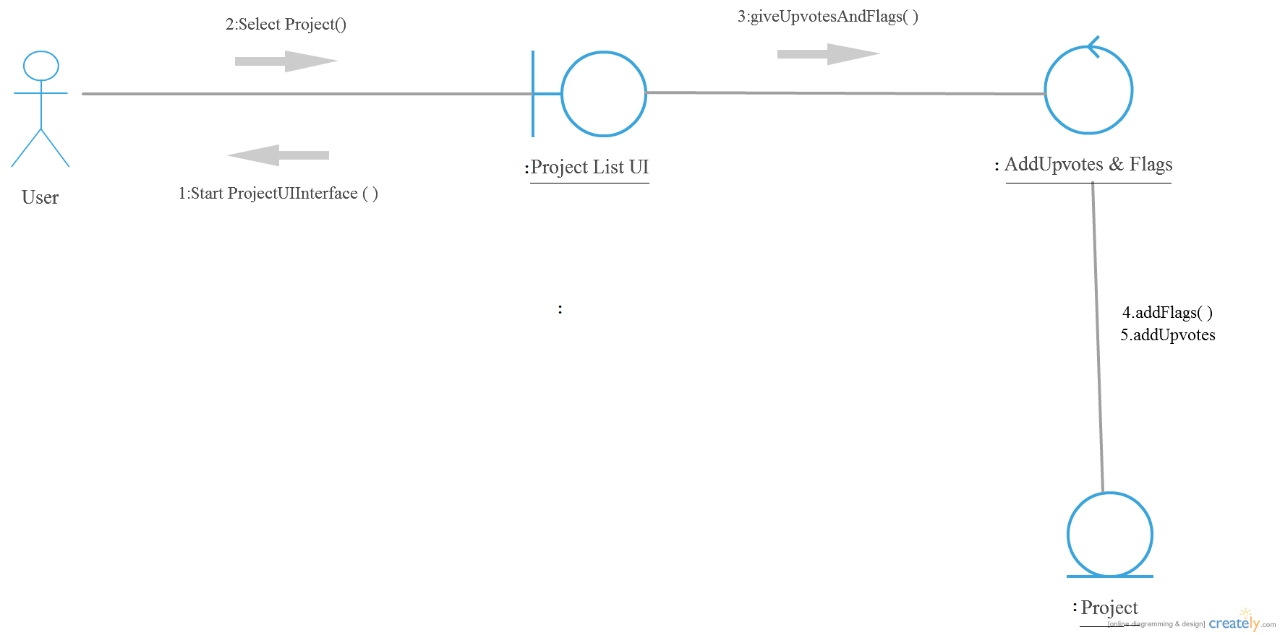
3.4 Class Diagram of FlagAndUpvote

Slide 28
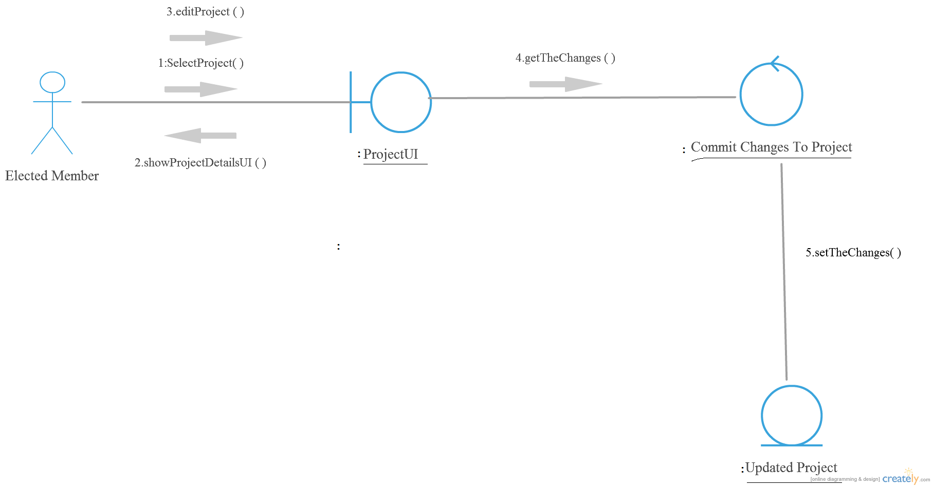
3.5 Class Diagram of UpdateProject

Slide 29
Distributed Content Generation Subsystem

Slide 30
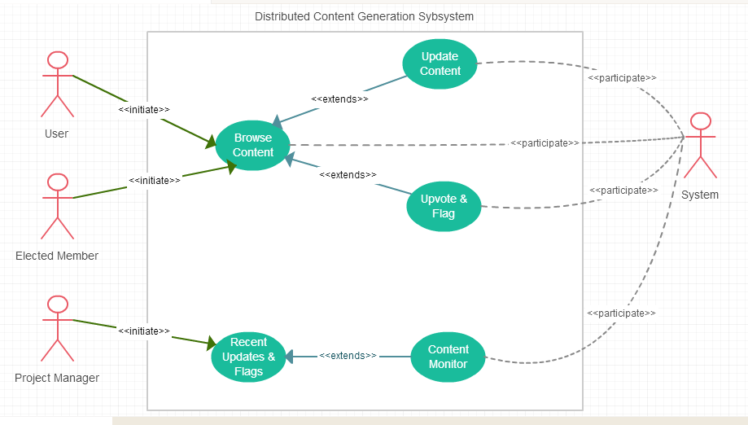
Use Case Diagram

Slide 31
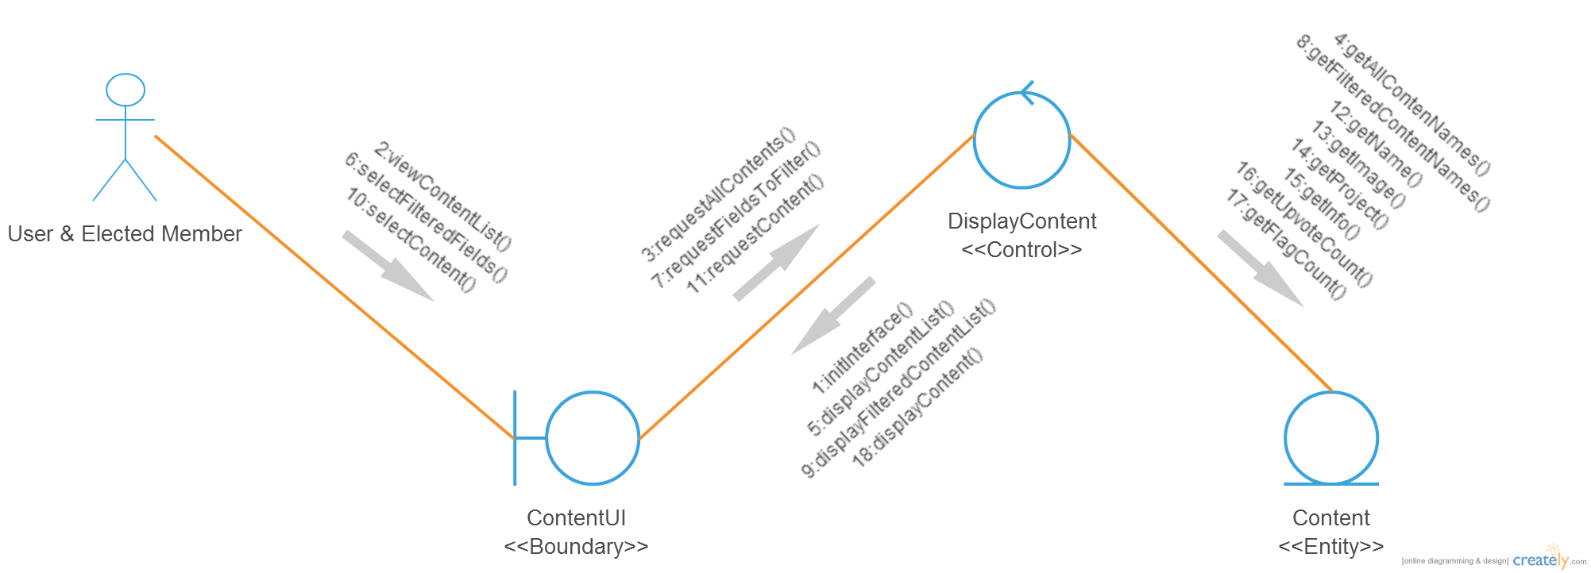
4.1 Class Diagram of BrowseContent

Slide 32
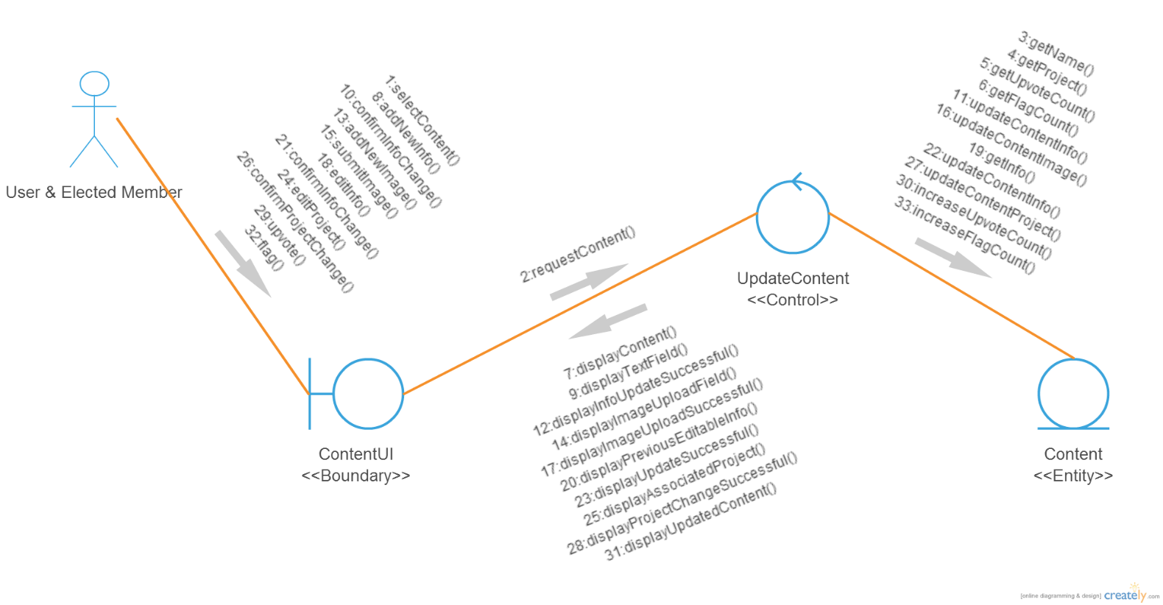
4.2 Class Diagram of UpdateContent

Slide 33
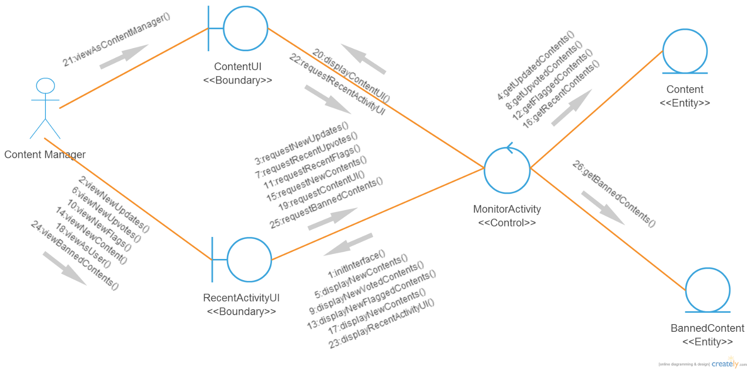
4.3 Class Diagram of ContentActivity

Slide 34
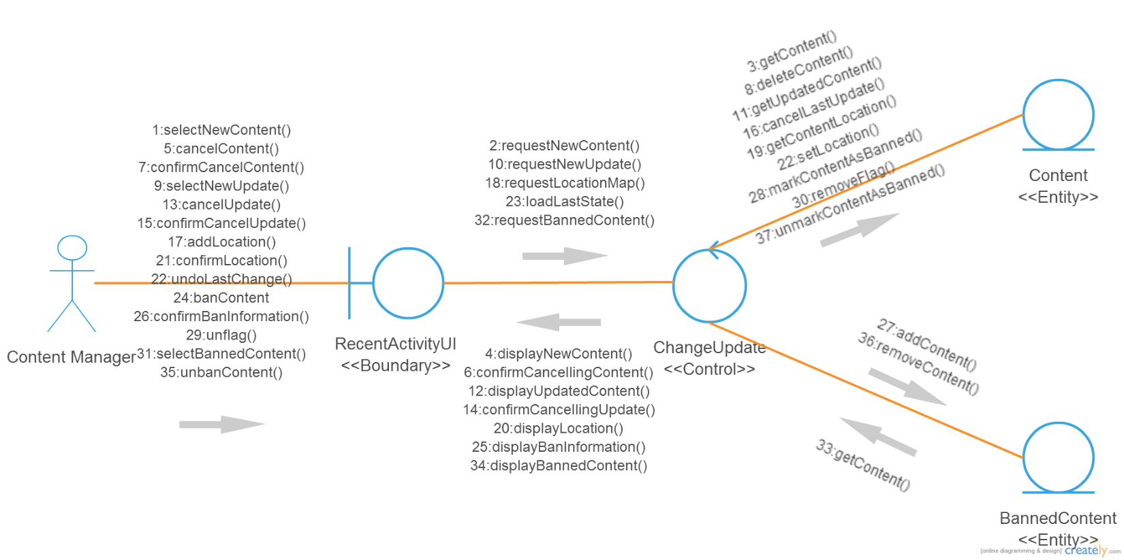
4.4 Class Diagram of MonitorContent

Slide 35
Big Data Analytics Subsystem

Slide 36
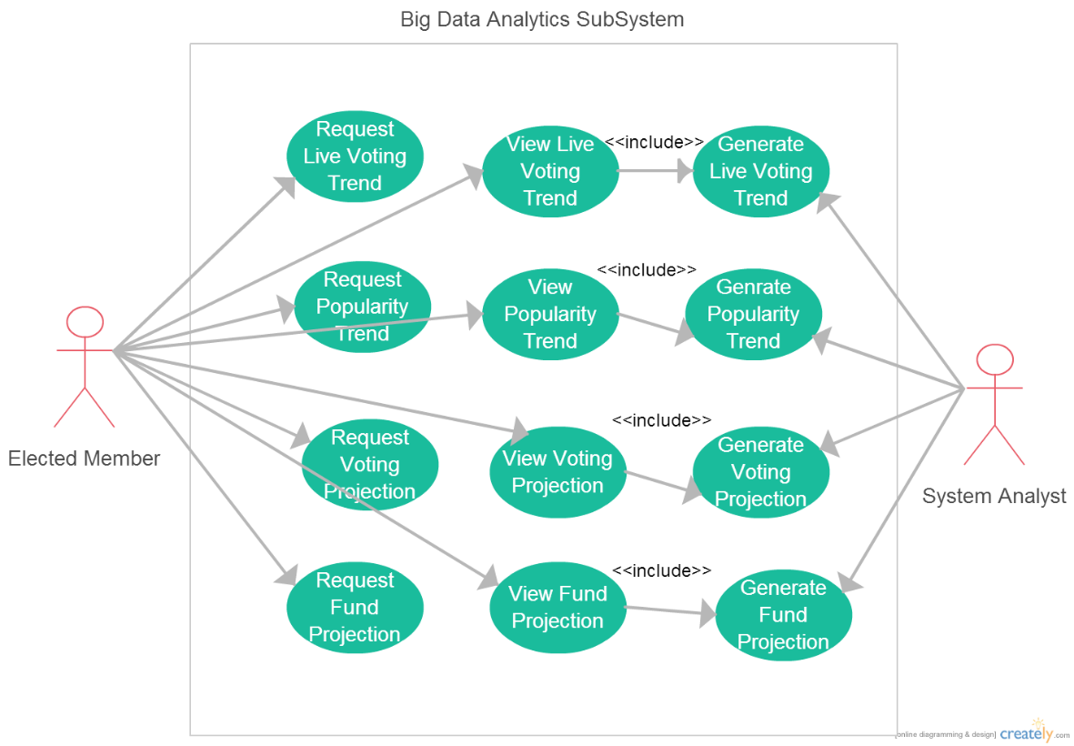
Use Case Diagram

Slide 37
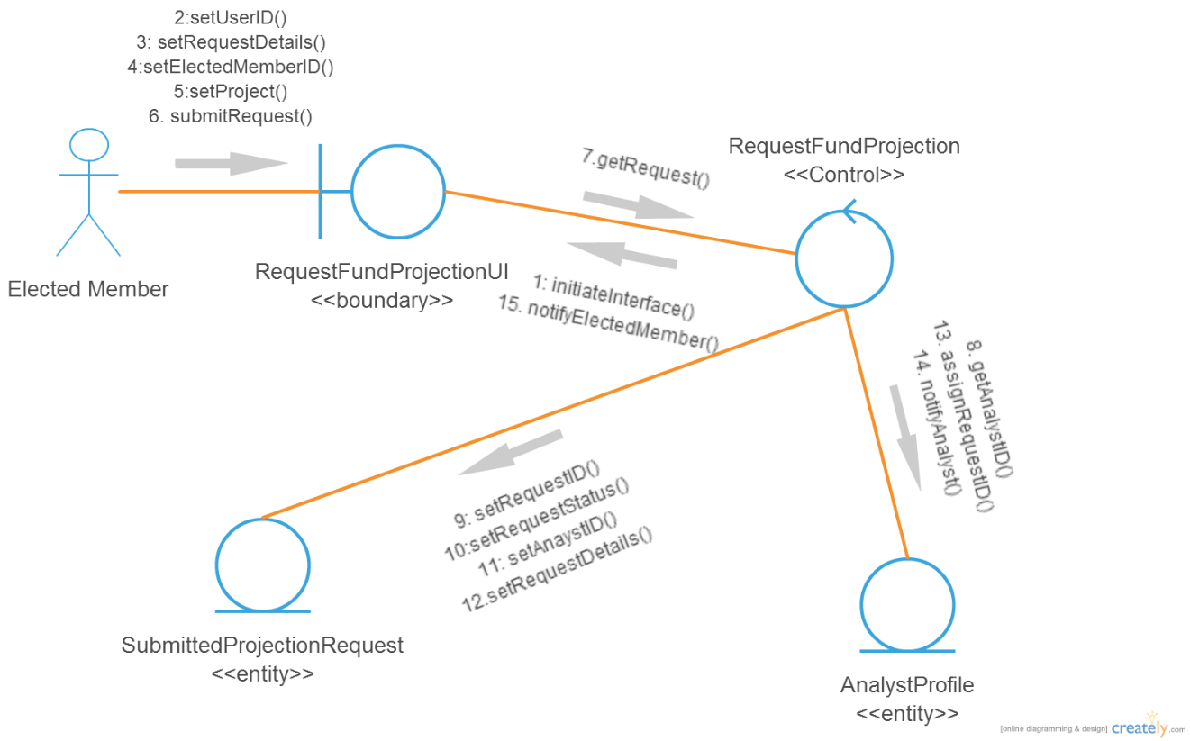
5.1 Class Diagram of RequestFundProjection

Slide 38
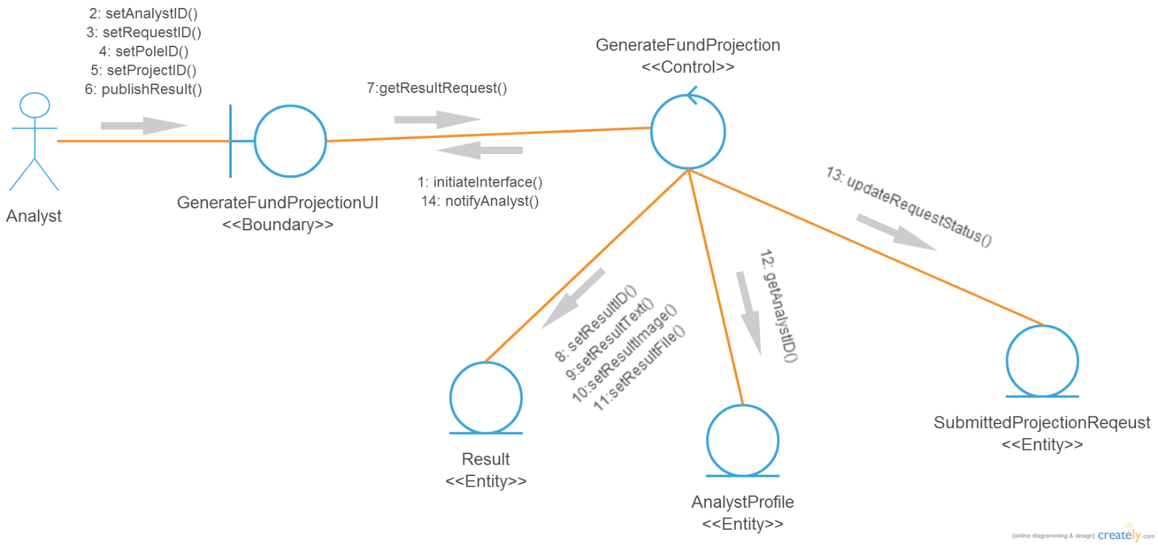
5.2 Class Diagram of GenerateFundProjection

Slide 39
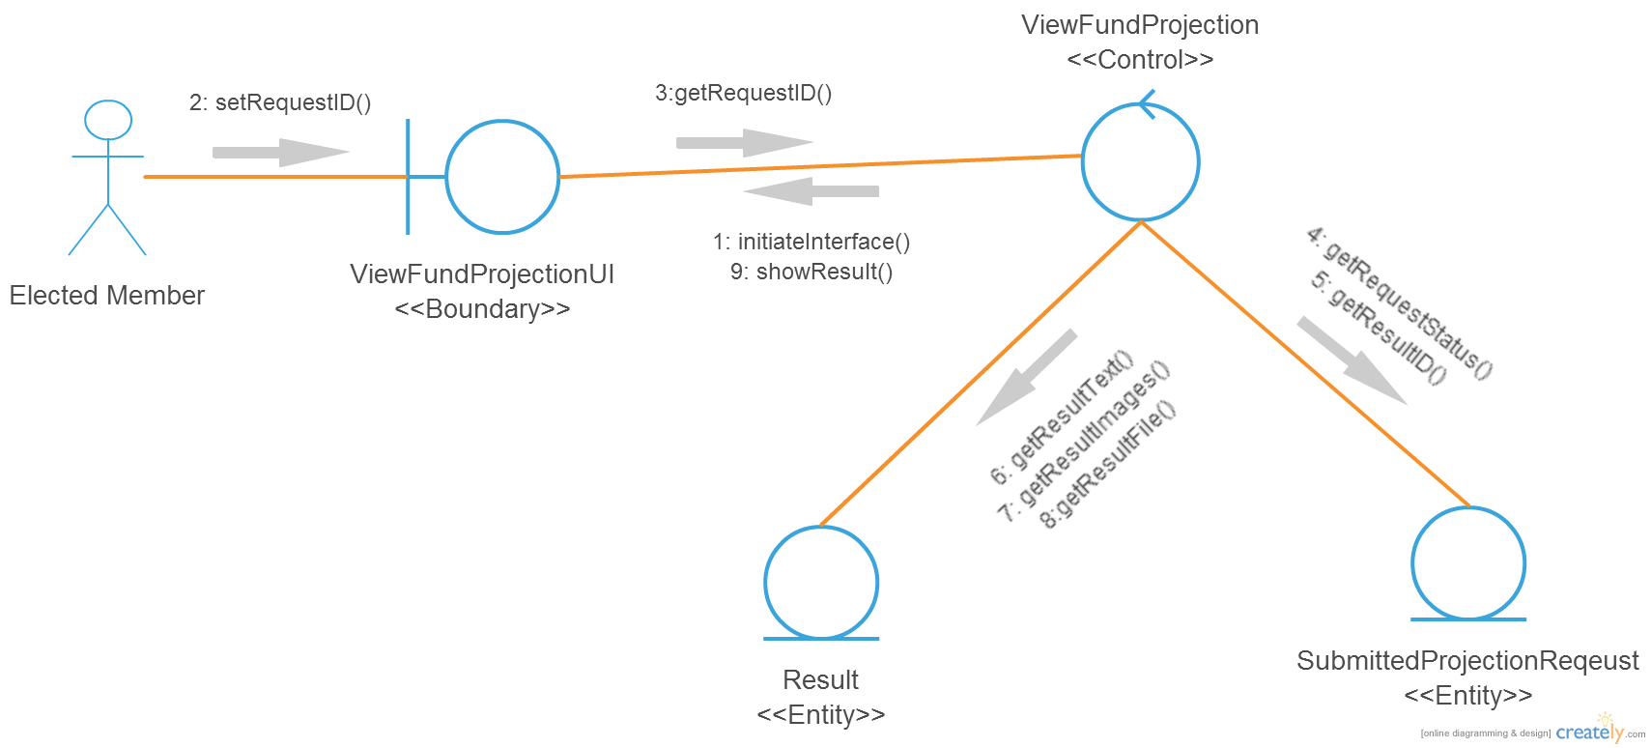
5.3 Class Diagram of ViewFundProjection

Slide 40
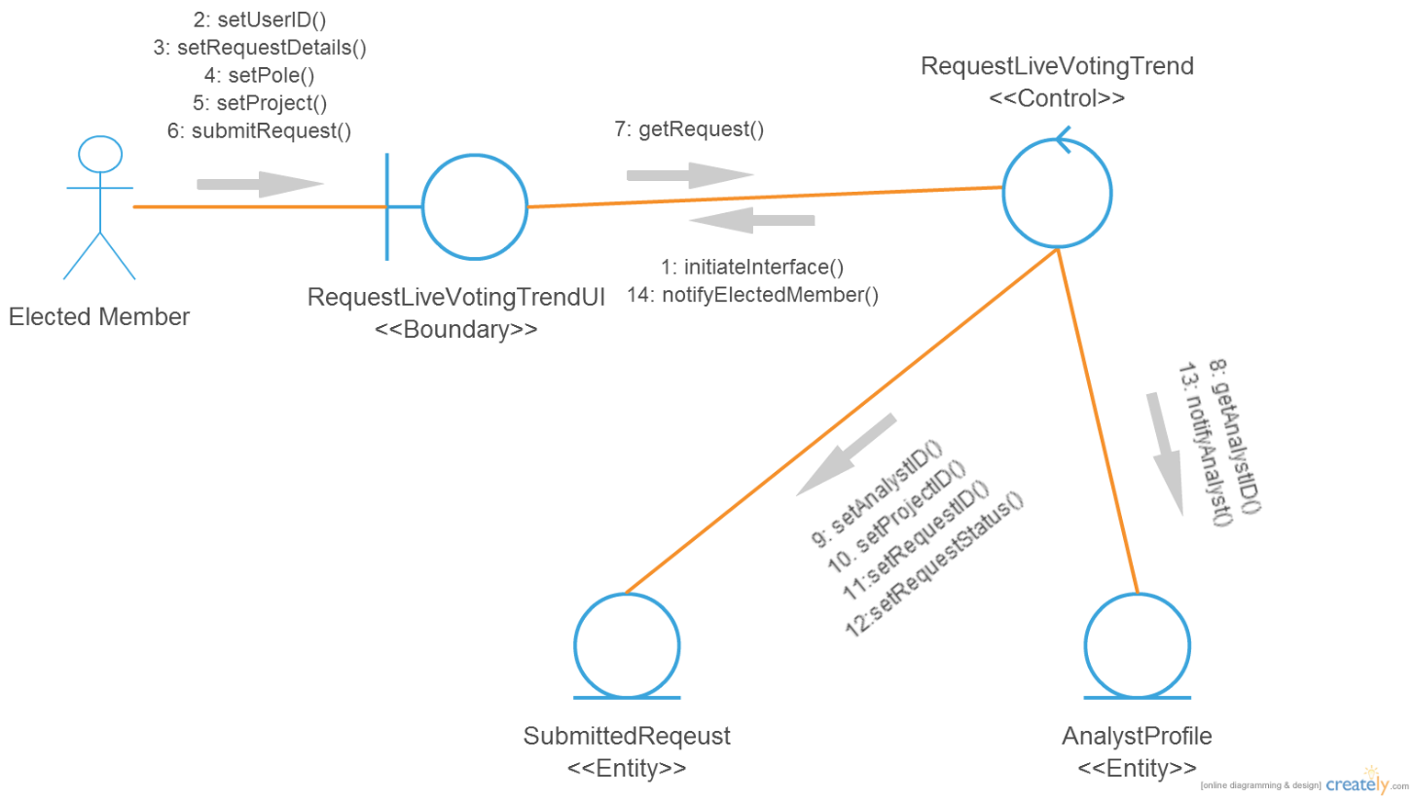
5.4 Class Diagram of RequestLiveVotingTrend

Slide 41
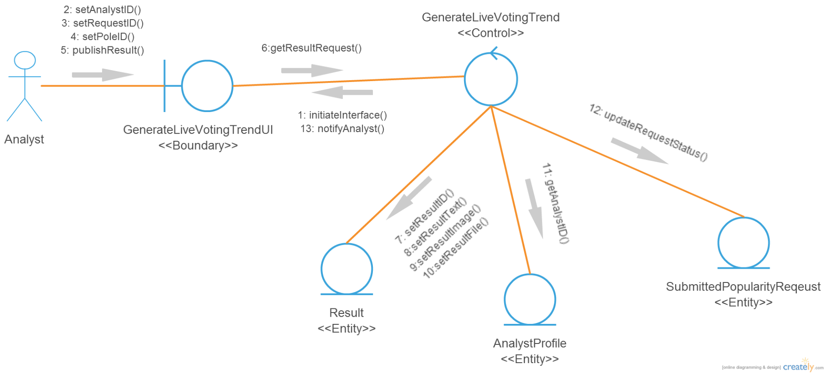
5.5 Class Diagram of GenerateLiveVotingTrend

Slide 42
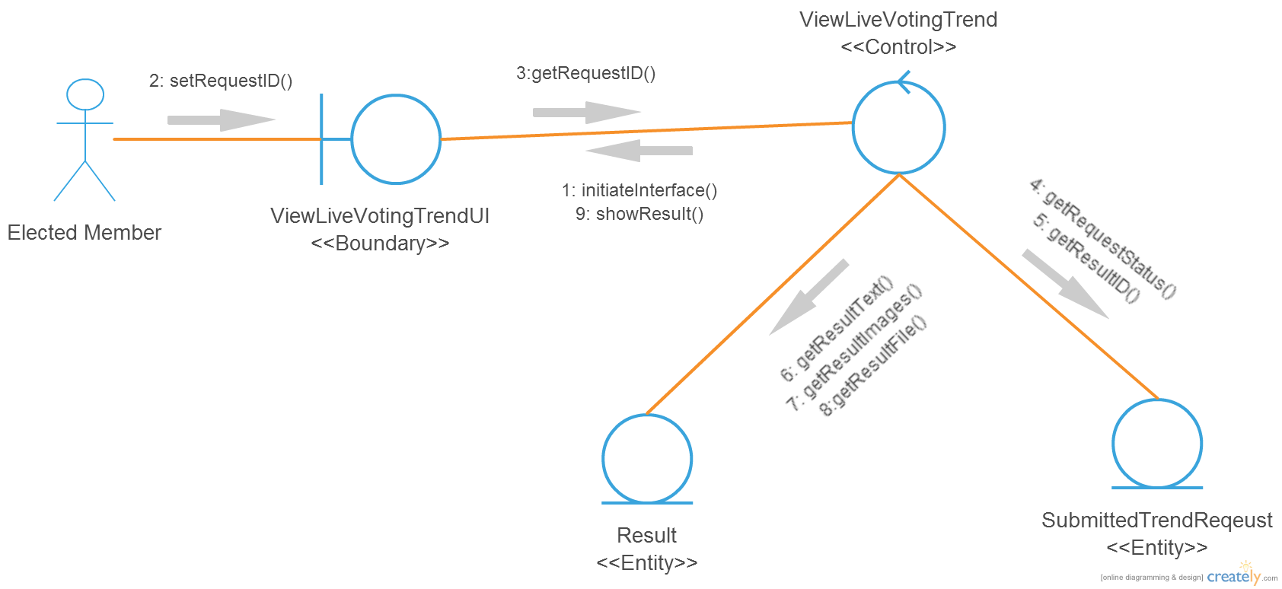
5.6 Class Diagram of ViewLiveVotingTrend

Slide 43
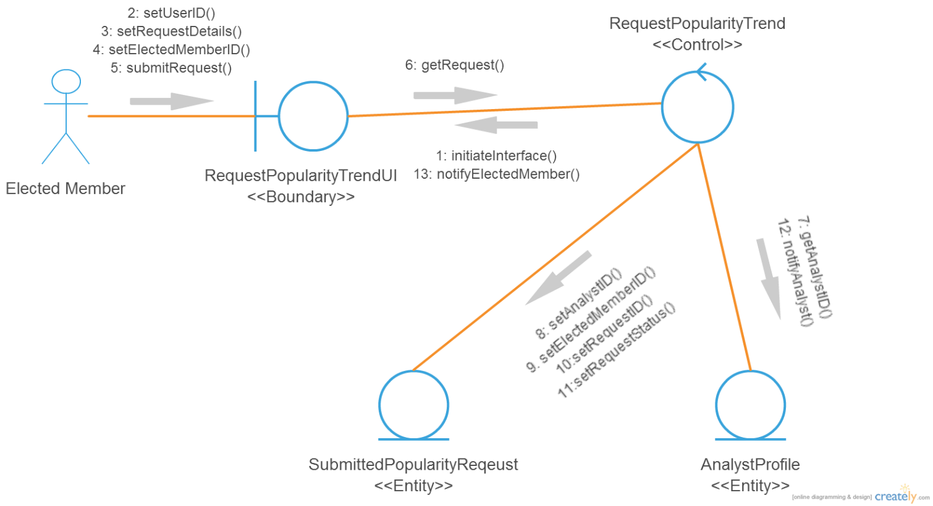
5.7 Class Diagram of RequestPopularityTrend

Slide 44
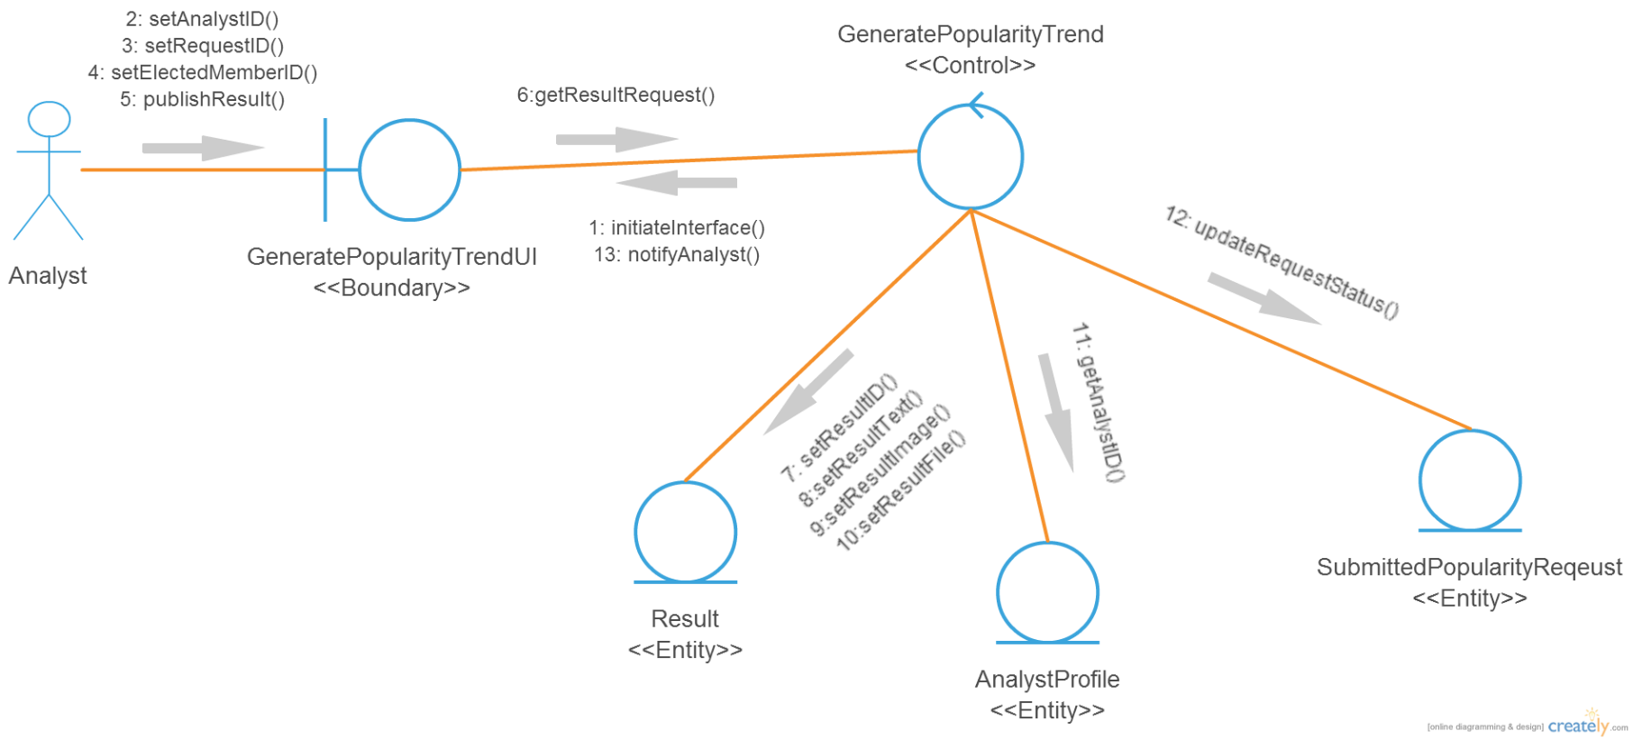
5.8 Class Diagram of GeneratePopularityTrend

Slide 45
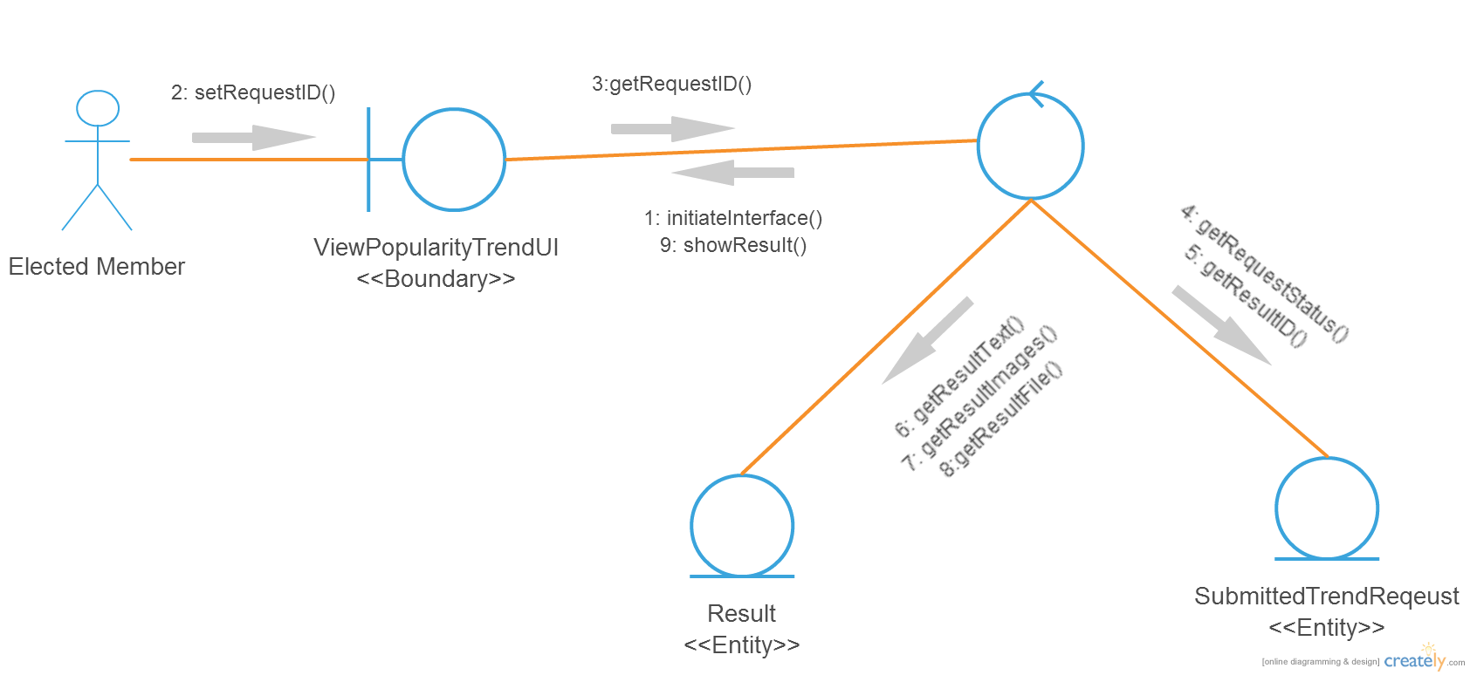
5.9 Class Diagram of ViewPopularityTrend
ViewPopularityTrend
<<Control>>

Slide 46

5.10 Class Diagram of RequestVotingProjection

Slide 47

5.11 Class Diagram of GenerateVotingProjection

Slide 48

5.12 Class Diagram of ViewVotingProjection

Slide 49
Thank You

